Slide 1
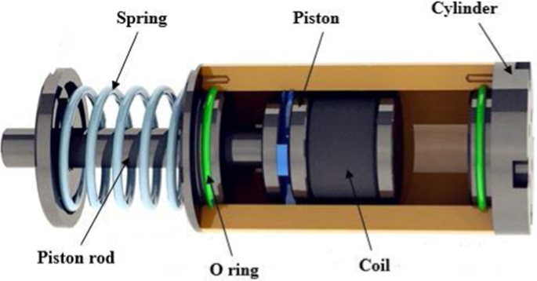
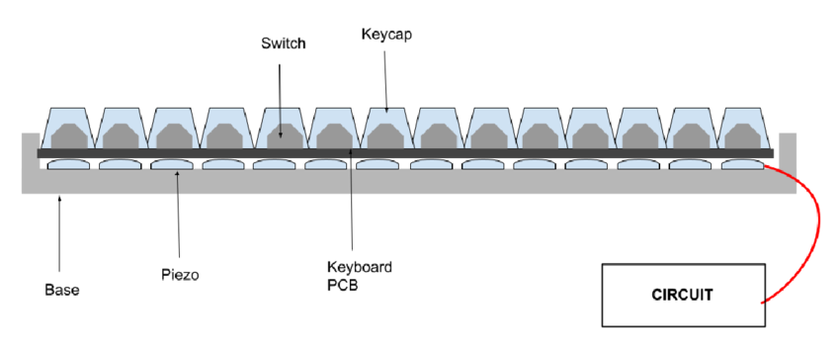
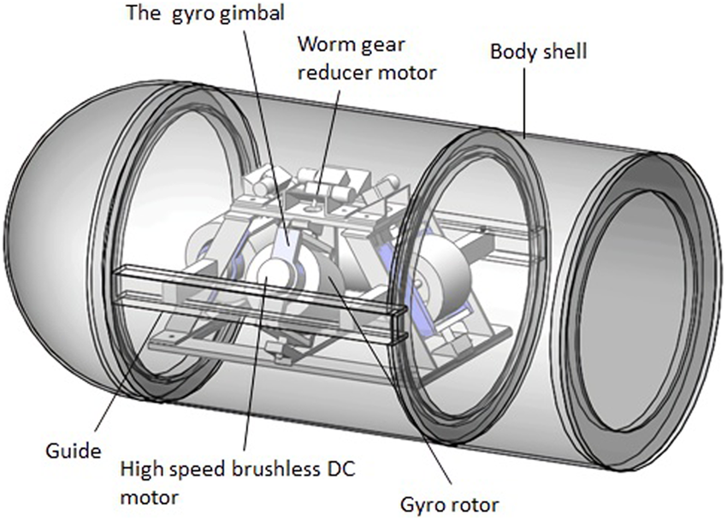
Magneto-Rheological (MR) Fluids in Foundations
Gyroscopic Precession for Deep-Sea Vehicle Propulsion
Self-Powered Keyboard Using Piezoelectric Materials
Concept: Piezoelectric materials beneath the keys convert typing force into electrical energy, powering the keyboard or recharging devices.
Applications:
Wireless, battery-free keyboards for laptops and PCs.
Sustainable IoT input devices generating their own power.
Emergency keyboards for disaster zones or remote locations.
Advantages: Eliminates the need for external power sources. Enhances device longevity and reduces energy consumption. Ideal for off-grid and low-resource environments. References:https://www.researchgate.net/publication/371519455_A_Piezoelectric_Energy_Harvester_for_Mechanical_Keyboards_to_Enable_Self-Powered_Computers
Concept: MR fluids change viscosity with a magnetic field, stiffening instantly to absorb seismic energy.
Applications:
Adaptive damping in skyscrapers and bridges.
Protection of sensitive equipment in seismic zones.
Real-time structural reinforcement in military bunkers.
Advantages: Provides instant response to external forces. Increases structural safety with minimal maintenance. Energy-efficient compared to traditional damping systems. References:https://www.sciencedirect.com/topics/earth-and-planetary-sciences/magnetorheological-fluid
Concept: A spinning gyroscope inside the vehicle generates torque, and through precession, produces directional force for maneuvering in extreme depths.
Applications:
Autonomous deep-sea exploration in trenches.
Military-grade UUVs for stealth operations.
Studying deep-sea ecosystems with minimal disturbance.
Advantages: Enables efficient maneuvering in high-pressure environments. Reduces reliance on traditional thrusters. Provides silent, low-impact propulsion for sensitive ecosystems.
References:https://ietresearch.onlinelibrary.wiley.com/doi/full/10.1049/iet-rpg.2015.0210
Name: Dhruv Pankhania Roll No. 16010124216 Division: C4

